Slide 1
Unsupervised Learning

Slide 2
f₁,f₂,f₃,f₄,f₅,f₆,f₇….f_{n} O/P
f₁,f₂,f₃,f₄,f₅,f₆,f₇….f_{n}
Supervised Learning
Unsupervised Learning

Slide 3
Introduction
Unsupervised learning uses machine learning algorithms to analyze and cluster unlabeled data sets. These algorithms discover hidden patterns in data without the need for human intervention.
Unsupervised learning models are used for three main tasks: clustering, association and dimensionality reduction:
Clustering is a data mining technique for grouping unlabeled data based on their similarities or differences. For example, K-means, hierarchical and DBSCAN Clustering.
Association is another type of unsupervised learning method that uses different rules to find relationships between variables in a given data set.
Dimensionality reduction is a learning technique that is used when the number of features (or dimensions) in a given data set is too high. It reduces the number of data inputs to a manageable size while also preserving the data integrity.

Slide 4
K-Means Algorithm

Slide 5
Datasets
Salary | Spending Score (1-10)
1,00,000 | 8
1,20,000 | 3
1,15,000 | 2
1,30,000 | 4
1,40,000 | 3
50,000 | 8
1,45,000 | 7
1,00,000 | 4
1,20,000 | 7
1,15,000 | 9
1,30,000 | 5
40,000 | 8
40,000 | 2
1,45,000 | 9
Spending Score
salary

Slide 6
Introduction
The K-Means algorithm clusters data by trying to separate samples in n groups of equal variance, minimizing a criterion known as the inertia or within-cluster sum-of-squares(wcss).

Slide 7
K-Means Clustering Algorithm
f₁,f₂,f₃,f₄,f₅,f₆,f₇….f_{n} as our inputs, and we want to split this into K clusters.
Follow the Steps:
Step 1: Choose K random points as cluster centers called centroids.
Step 2: Assign each x(i) to the closest cluster by implementing euclidean distance or manhattan distance (i.e., calculating its distance to each centroid)
Step 3: Identify new centroids by taking the average of the assigned points.
Step 4: Keep repeating step 2 and step 3 until convergence is achieved

Slide 8
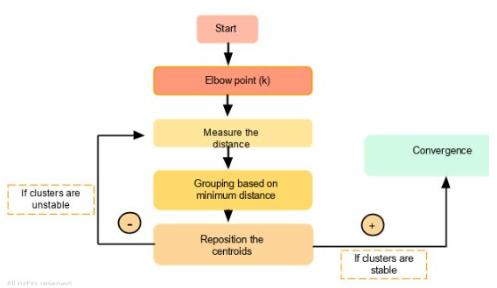
Flow chart of K-Means Clustering Algorithm

Slide 9
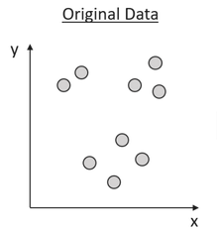
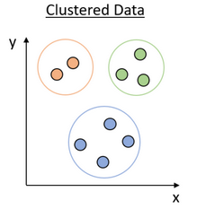
K-Means Clustering: Geometry Intrusion
K-Means

Slide 10
K-Means Clustering: Mathematical Intrusion
Steps:
Initialize some k→Centroid
Point that are nearest to Centroid → Group
Move to Centroid →Mean
Repeat step 2 & 3 until they are proper clustered.

Slide 11
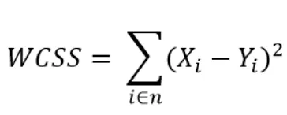
How select value of K
The k-means algorithm divides a set of N samples X into K disjoint clusters C , each described by the mean of the samples in the cluster. The means are commonly called the cluster “centroids”.

Slide 12
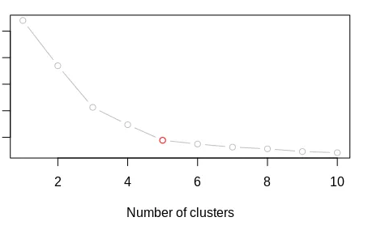
Elbow Method

Slide 13
WCSS
The Elbow Method is one of the most popular and appropriate methods.
The Elbow Method uses the idea of WCSS value, which is short for for Within Cluster Sum of Squares.
WCSS defines the total number of variations within a cluster.

Slide 14
Challenges With K-Means Clustering Algorithm
Noisy data
Uneven Cluster Sizes
Different Densities

Slide 15
Advantage | Disadvantage
K-means algorithm is simple,easy to understand and Implement | The user need to specify an initial value of K
It is also efficient, in which the taken to cluster K-means rises linearly with the no of data points | The process of finding the cluster may not converge
No other clustering algorithm perform better than K means for large data set | It is not suitable for discovering clusters that are not hyper ellipsoids or hyper spheres

Slide 16
Example: A1(2,10),A2(2,5),A3(8,4),B1(5,8),B2(7,5),B3(6,4),C1(1,2),C2(4,9). Find the cluster using K-means clustering

Slide 17
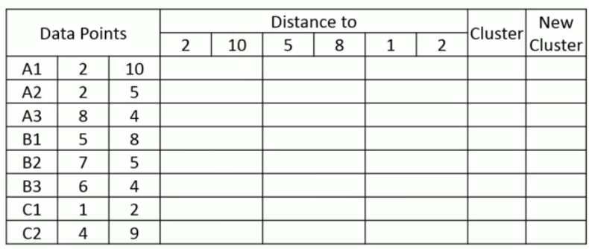
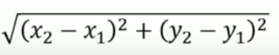
Initial Centroid: C1(2,10),C2(5,8),C3(1,2)
Euclidean Distance:

Slide 18
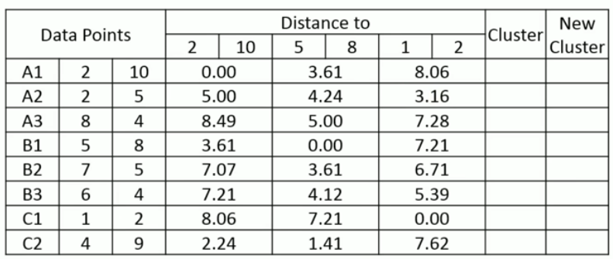

Slide 19
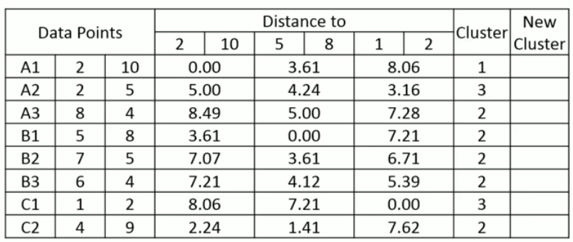
Here, A3,B1,B2,B3,C2 are in same cluster so take average of data point and make new centroid for cluster 2.
A2 and C2 are in same cluster so take it average and make new centroid for C3

Slide 20
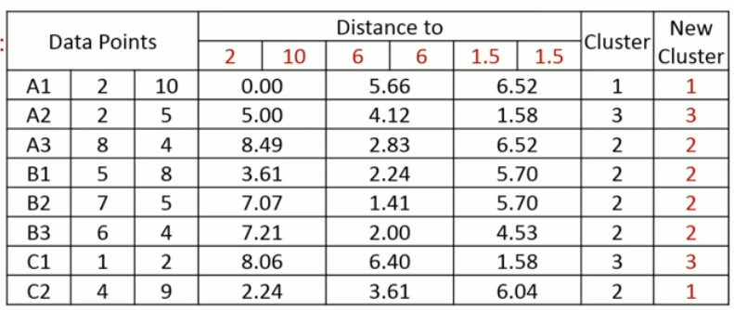
New Centroid: C1(2,10),C2(6,6),C3(1.5,3.5)
Here, C2 point is moving form Cluster 2 to 1 so, we have calculate A1 and C2 average for new centroid for cluster C1 & C2

Slide 21
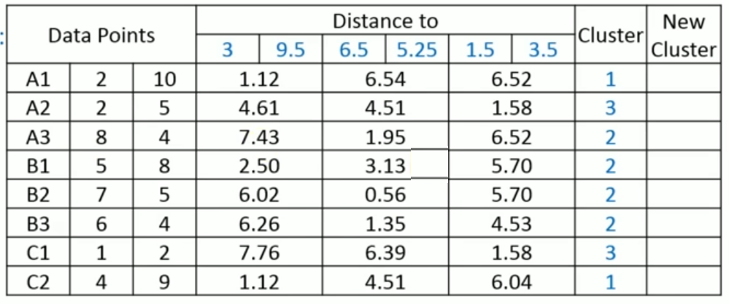
New Centroid: A(3,9.5) C2(6.5,5.25) C3(1.5,3.5)

Slide 22
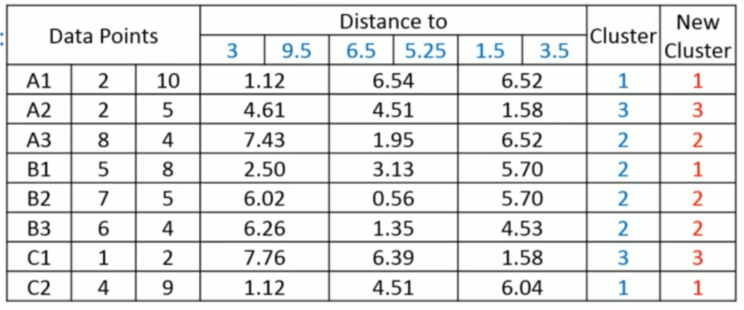
New Centroid: C1(3,9.5) C2(6.5,5.25) C3(1.5,3.5)
Here, B1 point moving from Cluster 2 to 1 so we have to find new centroid for C1 & C2

Slide 23
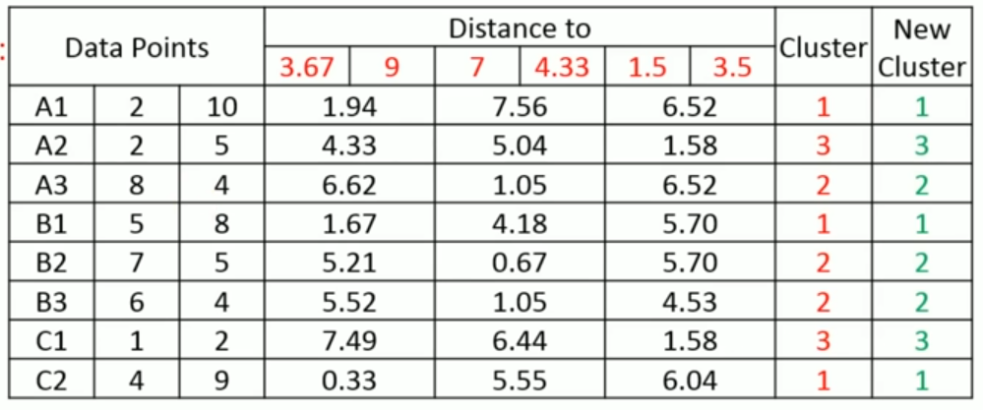
New Centroid: C1(3.67,9) C2(7,4.33) C3(1.5,3.5)

Slide 24
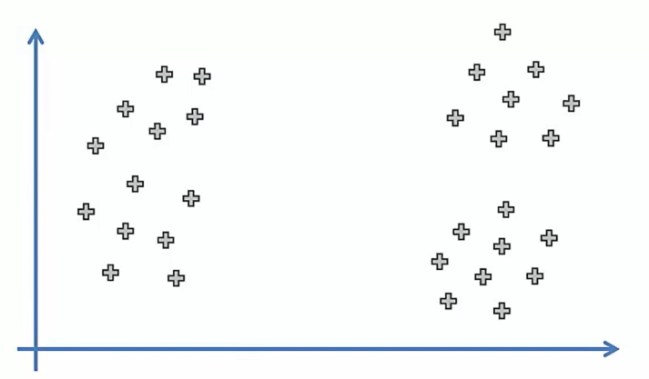
Random Initialization Trap (K-Means ++)

Slide 25
DBSCAN Clustering
Density-Based Spatial Clustering of Applications with Noise (DBSCAN) is a base algorithm for density-based clustering.
It can discover clusters of different shapes and sizes from a large amount of data, which is containing noise and outliers.
DBSCAN algorithm uses two parameters:
minPts: The minimum number of points (a threshold) clustered together for a region to be considered dense.
epsilon (ε): A distance measure that will be used to locate the points in the neighborhood of any point.

Slide 26
DBSCAN Clustering Working
DBSCAN algorithm a circle with a radius epsilon is drawn around each data point and the data point is classified into Core Point, Border Point, or Noise Point.
The data point is classified as a core point if it has minPoints number of data points with epsilon radius.
If it has points less than minPoints it is known as Border Point and if there are no points inside epsilon radius it is considered a Noise Point.

Slide 27
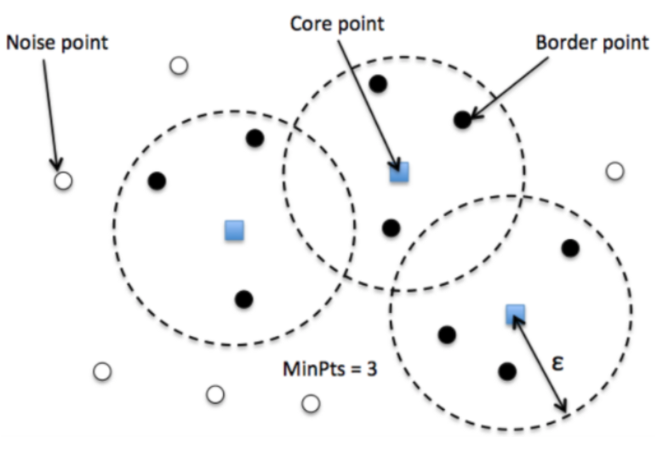

Slide 28
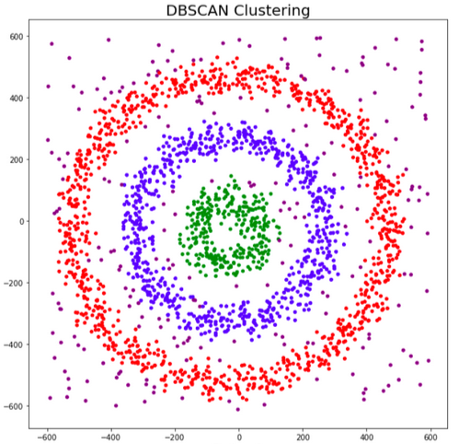

Slide 29
Reachability and Connectivity
Reachability states if a data point can be accessed from another data point directly or indirectly
Connectivity states whether two data points belong to the same cluster or not.
two points in DBSCAN can be referred to as:
Directly Density-Reachable
Density-Reachable
Density-Connected

Slide 30
Advantages | Disadvantages
It can find clusters with any shape. | It does not work with datasets that have varying densities.
It can also locate clusters that are not connected to any other group or clusters. It can work well with noisy clusters. | Cannot be employed with multiprocessing
It is robust to outliers. | Cannot find the right cluster if the dataset is sparse.
not require the number of centroids | It is sensitive to parameters epsilon and minPoints

Slide 31
Applications of DBSCAN
Satellite imagery.
X-Ray crystallography
Anomaly detection in temperature
Document Clustering
Recommendation Engine
Image Segmentation
Market Segmentation and
Search Result Grouping

Slide 32
Complexity of DBSCAN
Best Case: O(nlogn)
Worst Case: O(n²)
Average Case: Depending on data and implementation of the algorithm

Slide 33
DBSCAN Clustering Example
Q) Apply DBSCAN algorithm to the given data points and create the clusters with minimum point= 4 and epsilon (ε)= 1.9
P1= 3,7 P7=7,2
P2=4,6 P8=8,4
P3=5,5 P9=3,3
P4=6,4 P10=2,6
P5=7,3 P11=3,5
P6=6,2 P12=2,4

Slide 34
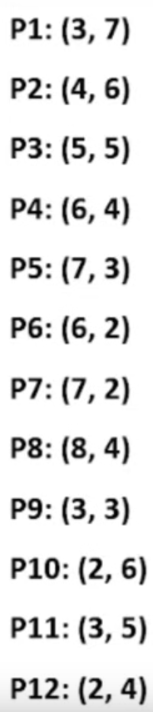
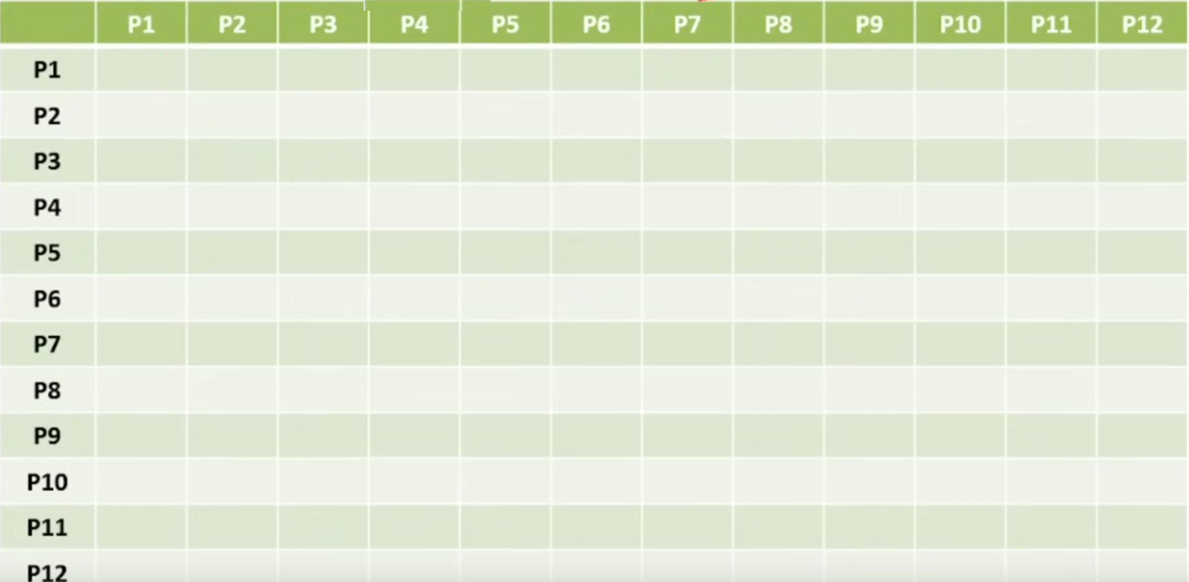
minimum point= 4 and epsilon (ε)= 1.9

Slide 35
Euclidean Distance Between Two Point

Slide 36
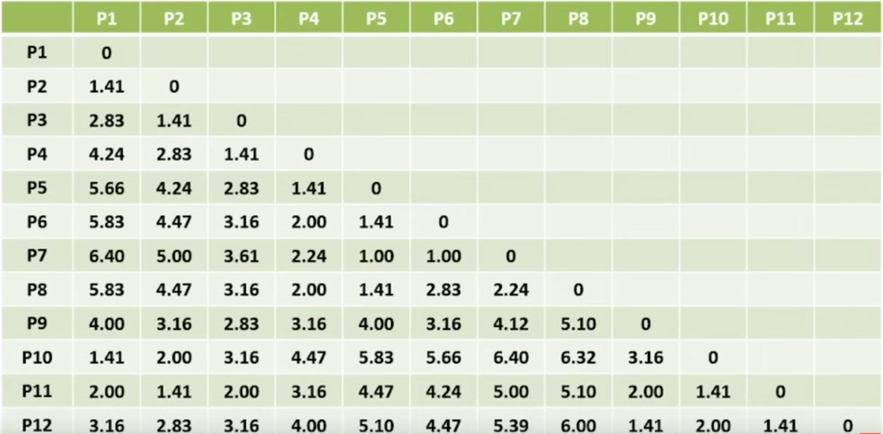
minimum point= 4 and epsilon (ε)= 1.9

Slide 37
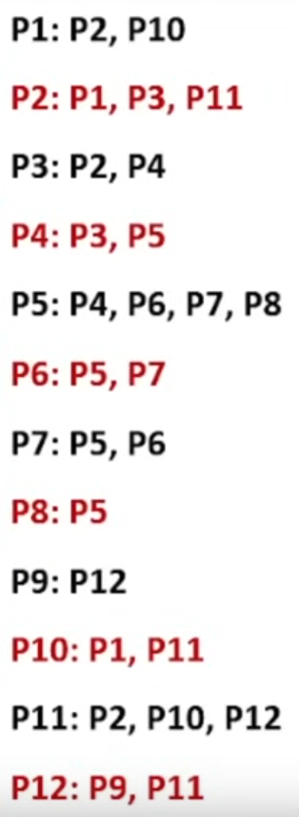
minimum point= 4 and epsilon (ε)= 1.9

Slide 38
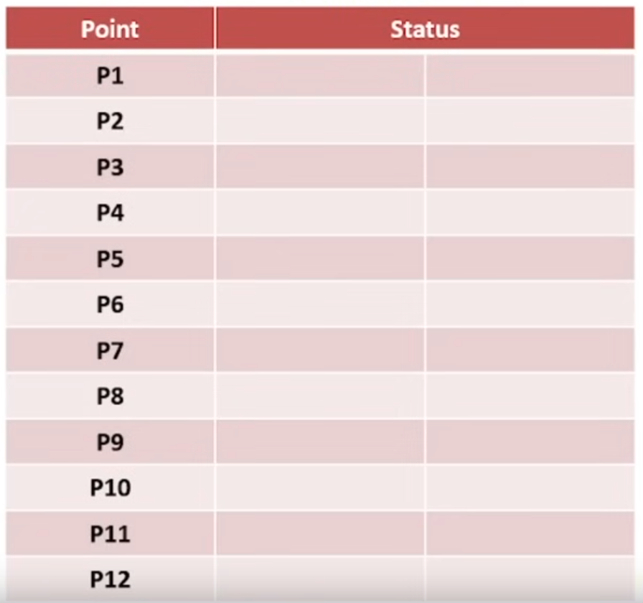

Slide 39
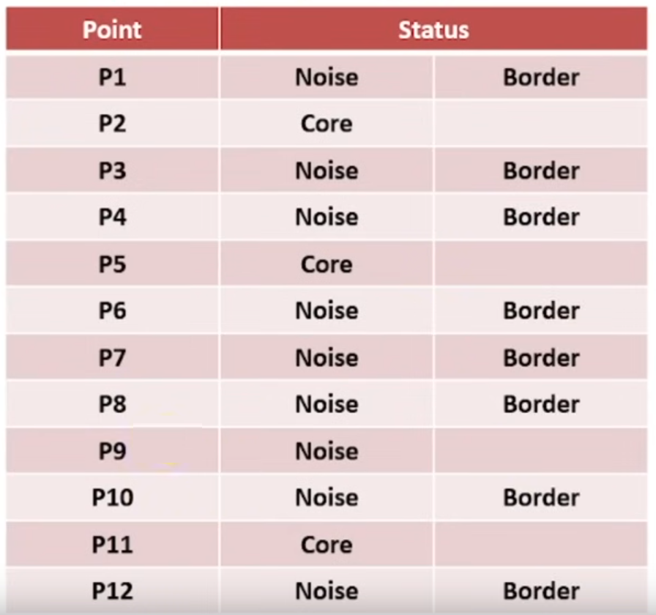

Slide 40
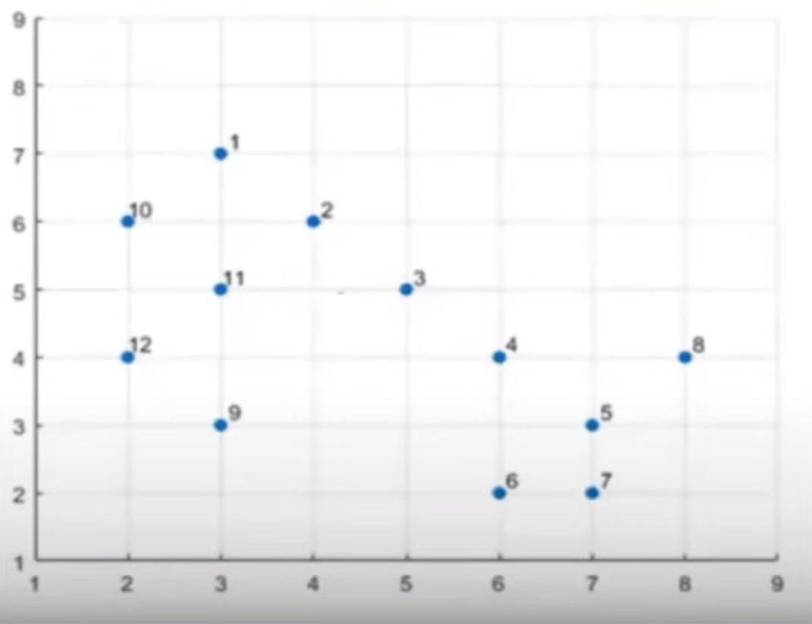
minimum point= 4 and epsilon (ε)= 1.9

Slide 41
Hierarchical clustering
Hierarchical clustering is a powerful unsupervised machine learning algorithm used to group data points into a hierarchy of clusters.
when the number of clusters is not predefined, and
it helps to visualize the data structure through a dendrogram, which represents the nested clustering relationships.

Slide 42
Why hierarchical clustering?
K-means clustering that there are some challenges with this algorithm, which are a predetermined number of clusters, and it always tries to create the clusters of the same size.

Slide 43
Types of Hierarchical Clustering
There are two major types of hierarchical clustering approaches:
Agglomerative clustering:
Agglomerative is a bottom-up approach, in which the algorithm starts with taking all data points as single clusters and merging them until one cluster is left.
Divide the data points into different clusters and then aggregate them as the distance decreases.
Divisive clustering:
Combine all the data points as a single cluster and divide them as the distance between them increases.
it is a top-down approach.

Slide 44
Hierarchical Clustering Algorithm
Steps 1: For each point initially, we will consider it as a separate cluster.
Step 2: Find the nearest point and make a cluster
Step 3:Keep on doing the the process[step 2] until we will get a single cluster
Divisive
Agglomerative

Slide 45
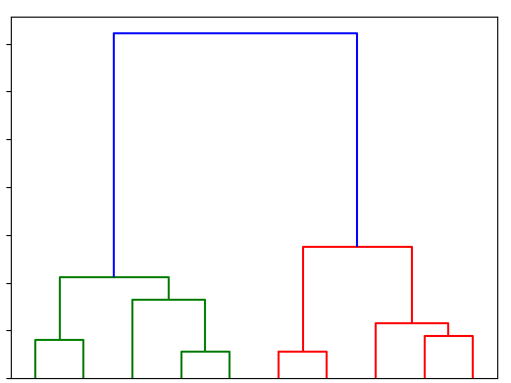
Dendrogram Charts
The way to find the optimal number of clusters in hierarchical clustering is to use a dendrogram chart.

Slide 46
Uses of Hierarchical Clustering
Market Segmentation
Geo-Spatial Analysis
Image Segmentation
Image Segmentation

Slide 47
Limits of Hierarchical Clustering
High time and space computational complexity.
No objective function for hierarchical clustering.
Due to high time complexity, it cannot be used for large datasets.
Sensitive to noise and outliers since we use distance metrics.
Difficulty handling large clusters.

Slide 48
Advantages of Hierarchical Clustering
No predefined clusters: Hierarchical clustering does not require specifying the number of clusters in advance.
Dendrogram for visualization: It allows the creation of dendrograms, providing a visual representation of clusters at various levels.
Cluster hierarchy: The hierarchical nature helps reveal nested clusters.

Slide 49
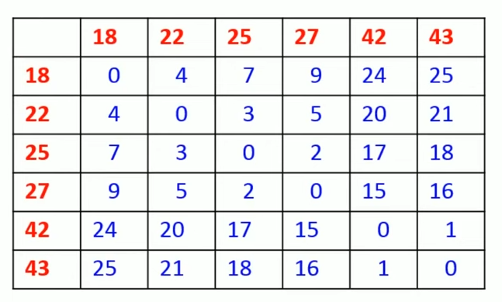
Example
Q) 18,22,25,42,27,43 one dimension data point find cluster and using agglomerative hierarchical clustering method.
Sol: Step 1

Slide 50
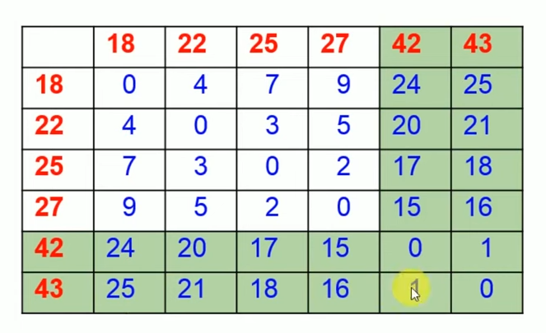

Slide 51
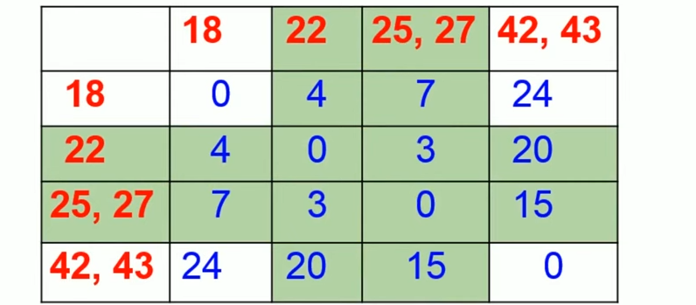

Slide 52
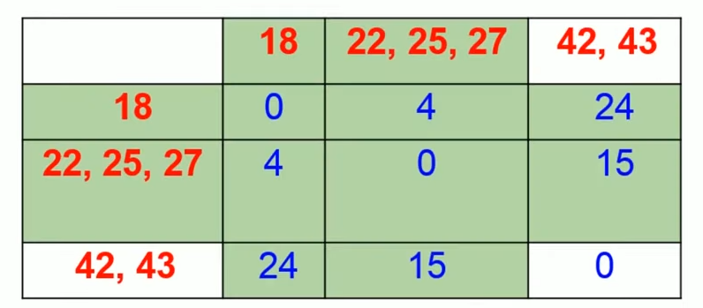

Slide 53
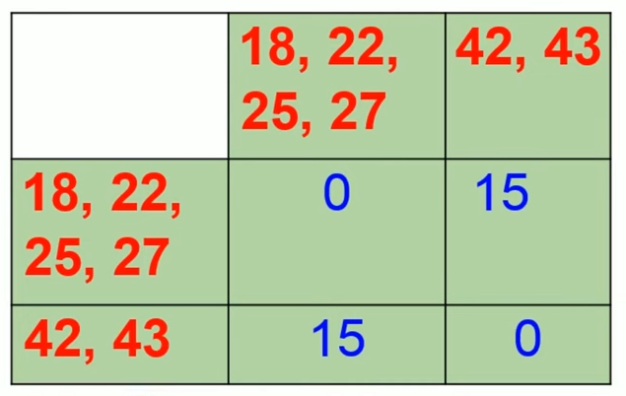
Step 4:

Slide 54
